Slide 1

Predicting Default of Credit Card Clients
Abiola Ijaola
DATA606 Capstone
UMBC
Final Presentation

Slide 2
Presentation Approach
Project overview
Check for data unbalance
Exploratory data analysis
Model construction
Execution & Interpretation
What could be done better?
Conclusions

Slide 3
Recap of the project
Dataset
The dataset is collected from Department of Information Management, Chung Hua University, Taiwan and Department of Civil Engineering, Tamkang University, Taiwan.
The source URLs for the data is
https://archive.ics.uci.edu/ml/datasets/default+of+credit+card+clients.
I will be using open source software and code (Python & Jupiter Notebook)

Slide 4
Exploratory Data Analysis
The purpose of exploratory data analysis is to perform pattern discovery analysis on data using summary statistics and graphical representations

Slide 5
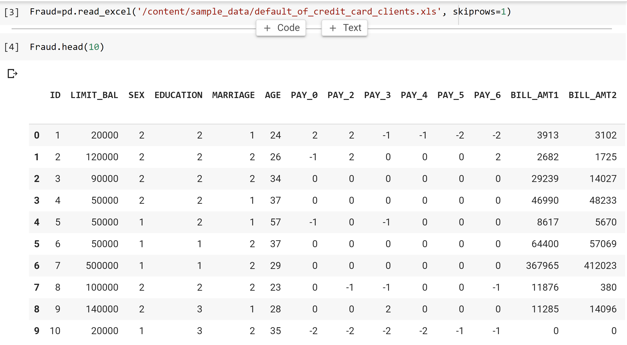
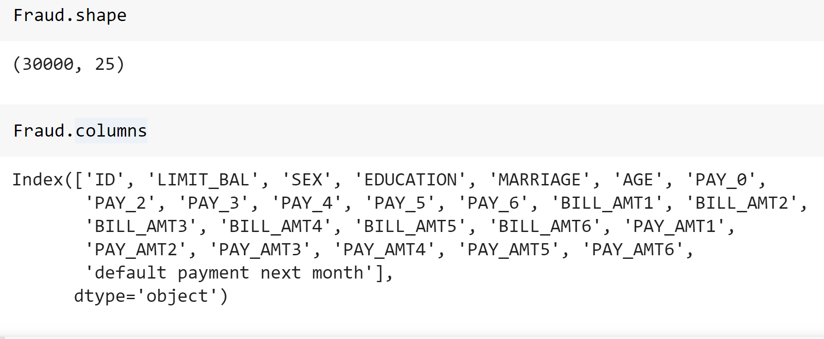
First Look

Slide 6
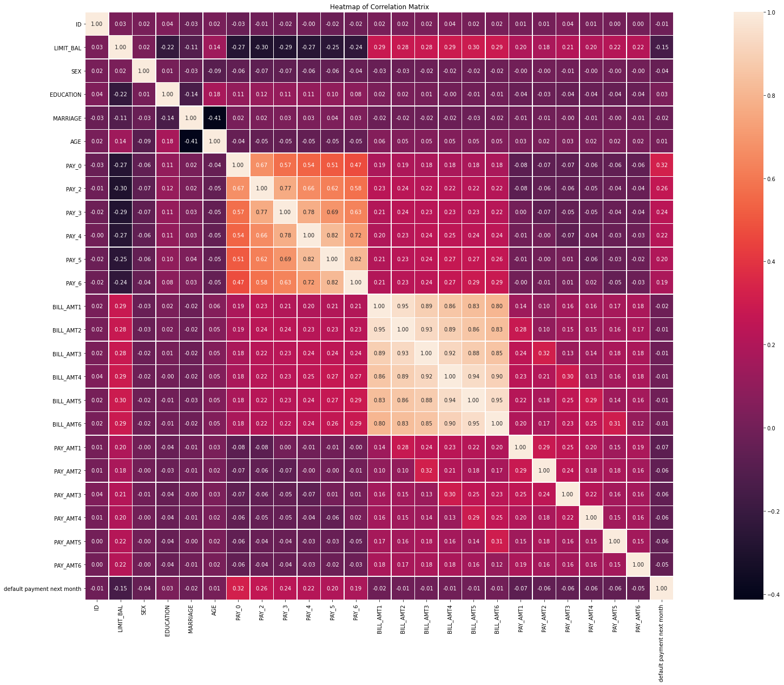
Correlations among variables
Based on the correlation matrix, there is a strong positive correlation between any two monthly payment status: in all such cases, the correlation coefficients were between 0.47 to 0.82. For instance, the payment status in September tends to increase as that of May (correlation coefficient, R = 0.51), similarly the payment status in April correlated positively with that of August (R = 0.58).

Slide 7
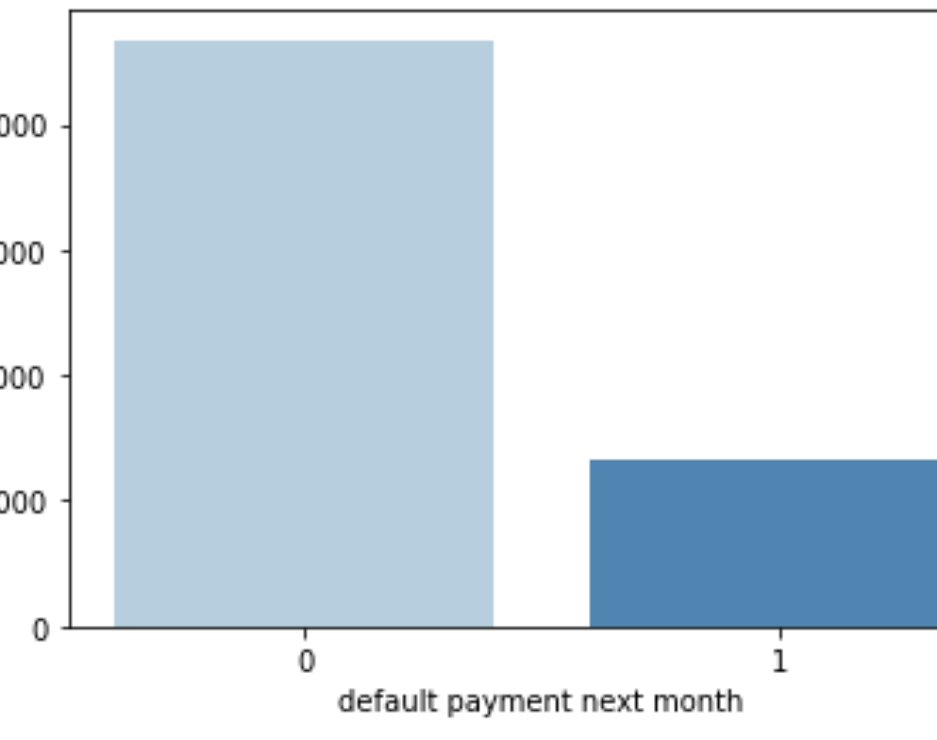
Frequency Plot for Default Payment
About 22% of the credit card clients default in their next monthly payment, while the remaining 78 % tend to meet their monthly credit card payment obligation.
0 - 23364
1 - 6636

Slide 8
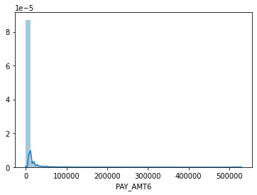
Distribution Plot for PAY_AMT6
The distribution plot for the amount of previous payment in April 2005 showed the most of the payment amount ranges between $0 to $ 30,000. Other higher amounts are present but at a much lesser count.

Slide 9
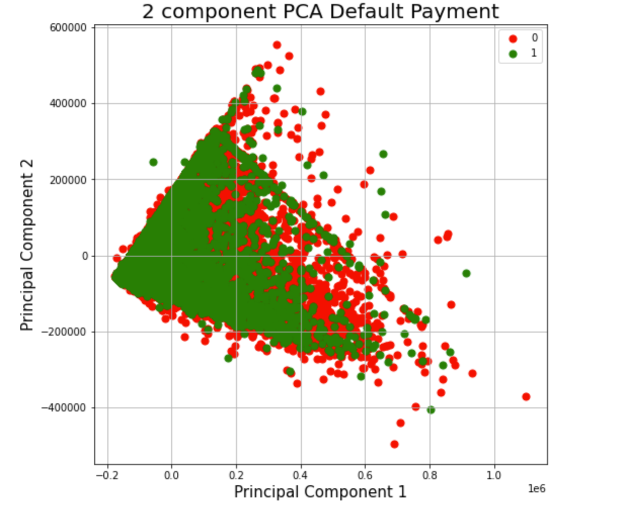
Principal Component Analysis (PCA)

Slide 10
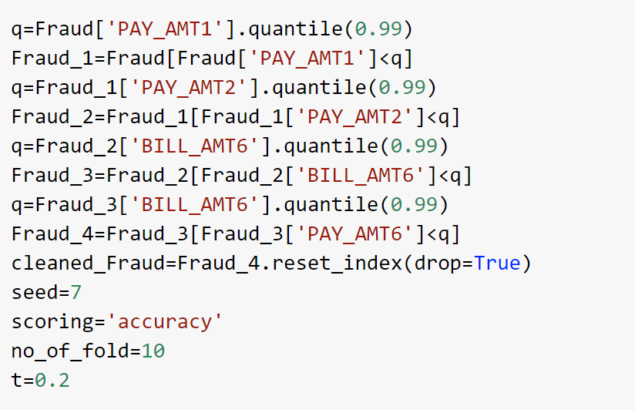
Outlier

Slide 11
Exploratory Data Analysis Outcome
All the data types are all int64.
There is no missing data in the entire dataset.
From my analysis, the result shows that we are dealing with
imbalance classes.

Slide 12
Model Construction
The purpose of the phase is to preprocess the data, train data using different ML algorithms, test model, and evaluate the accuracy of the model

Slide 13
Model construction Methodology
Split dataset into training and test sets.
Run Logistic Regression, Decision Tree, KNeighbors, Random Forest and Gaussian Algorithms
Test model
Check accuracy
Normalize dataset to eliminate effect of outliers

Slide 14
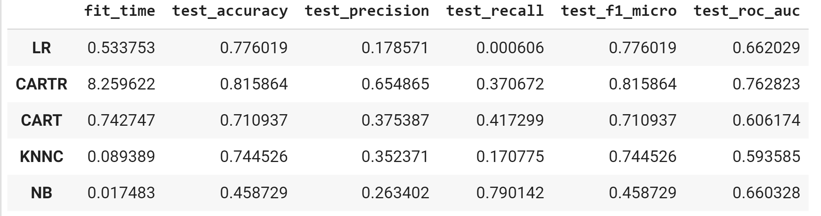
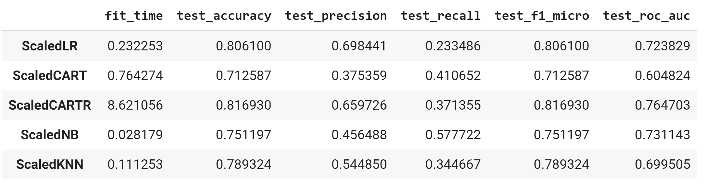
Execution & Interpretation
Model trained with Non-standardized Features
Model trained with standardized Features

Slide 15
What could be done better?
The training model in this project would be improved by tuning the hyperparameters of the algorithms such as L1/L2 regularization terms, learning rates across a parameter grid using GridSearchCV.
The development of learning curves for each of the five models to help identify the presence of high bias, high variance or both for further insights on how to improve the learning algorithms.
The use of more high-quality data and feature engineering.
The tuning of each classifier decision threshold (a default value of 0.5 was employed in this study).

Slide 16
Conclusion
Based on the auc_roc_score and f1_macro values, the Random Forest classifier was observed to be the best performing model among the five studied models for both standardized and non-standardized features.
With a roc_auc_score value of 0.76 on a decision threshold of 0.5, the Random forest classifier trained model is good, in terms of the predicted probability for distinguishing whether a consumer will default in his/her monthly credit card payment the given classes.
The micro-averaged f1_score (82%) for the choice model (Random Forest classifier), shows relatively better predictability with potential for improvement of the learning algorithms.

Slide 17
Thank you

